Slide 1
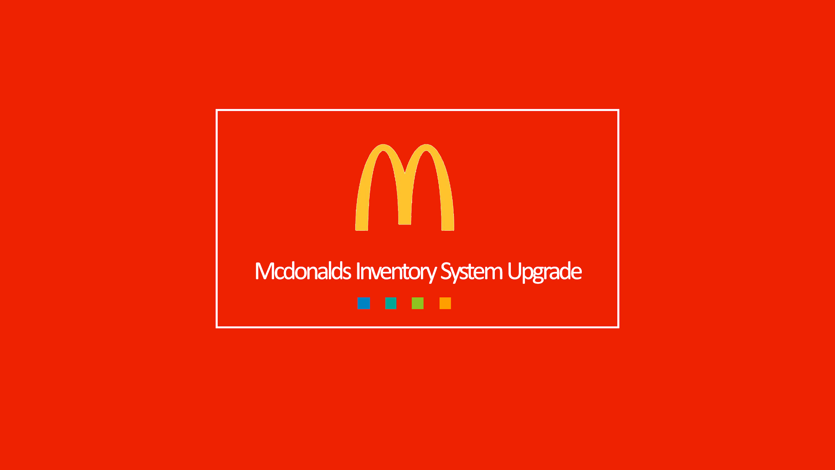

Slide 2
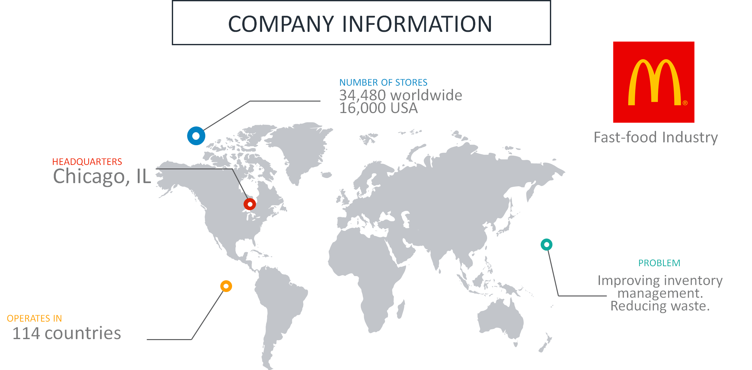
Notes:
What it does - produces fast food
▪ What Market does it operate in- restaurant/ fast food industry
▪ Size- The company is large, but we are focusing on 8 stores in FFX
▪ A problem / inefficiency they have- Inventory system does not calculate for shrinkage in real time

Slide 3
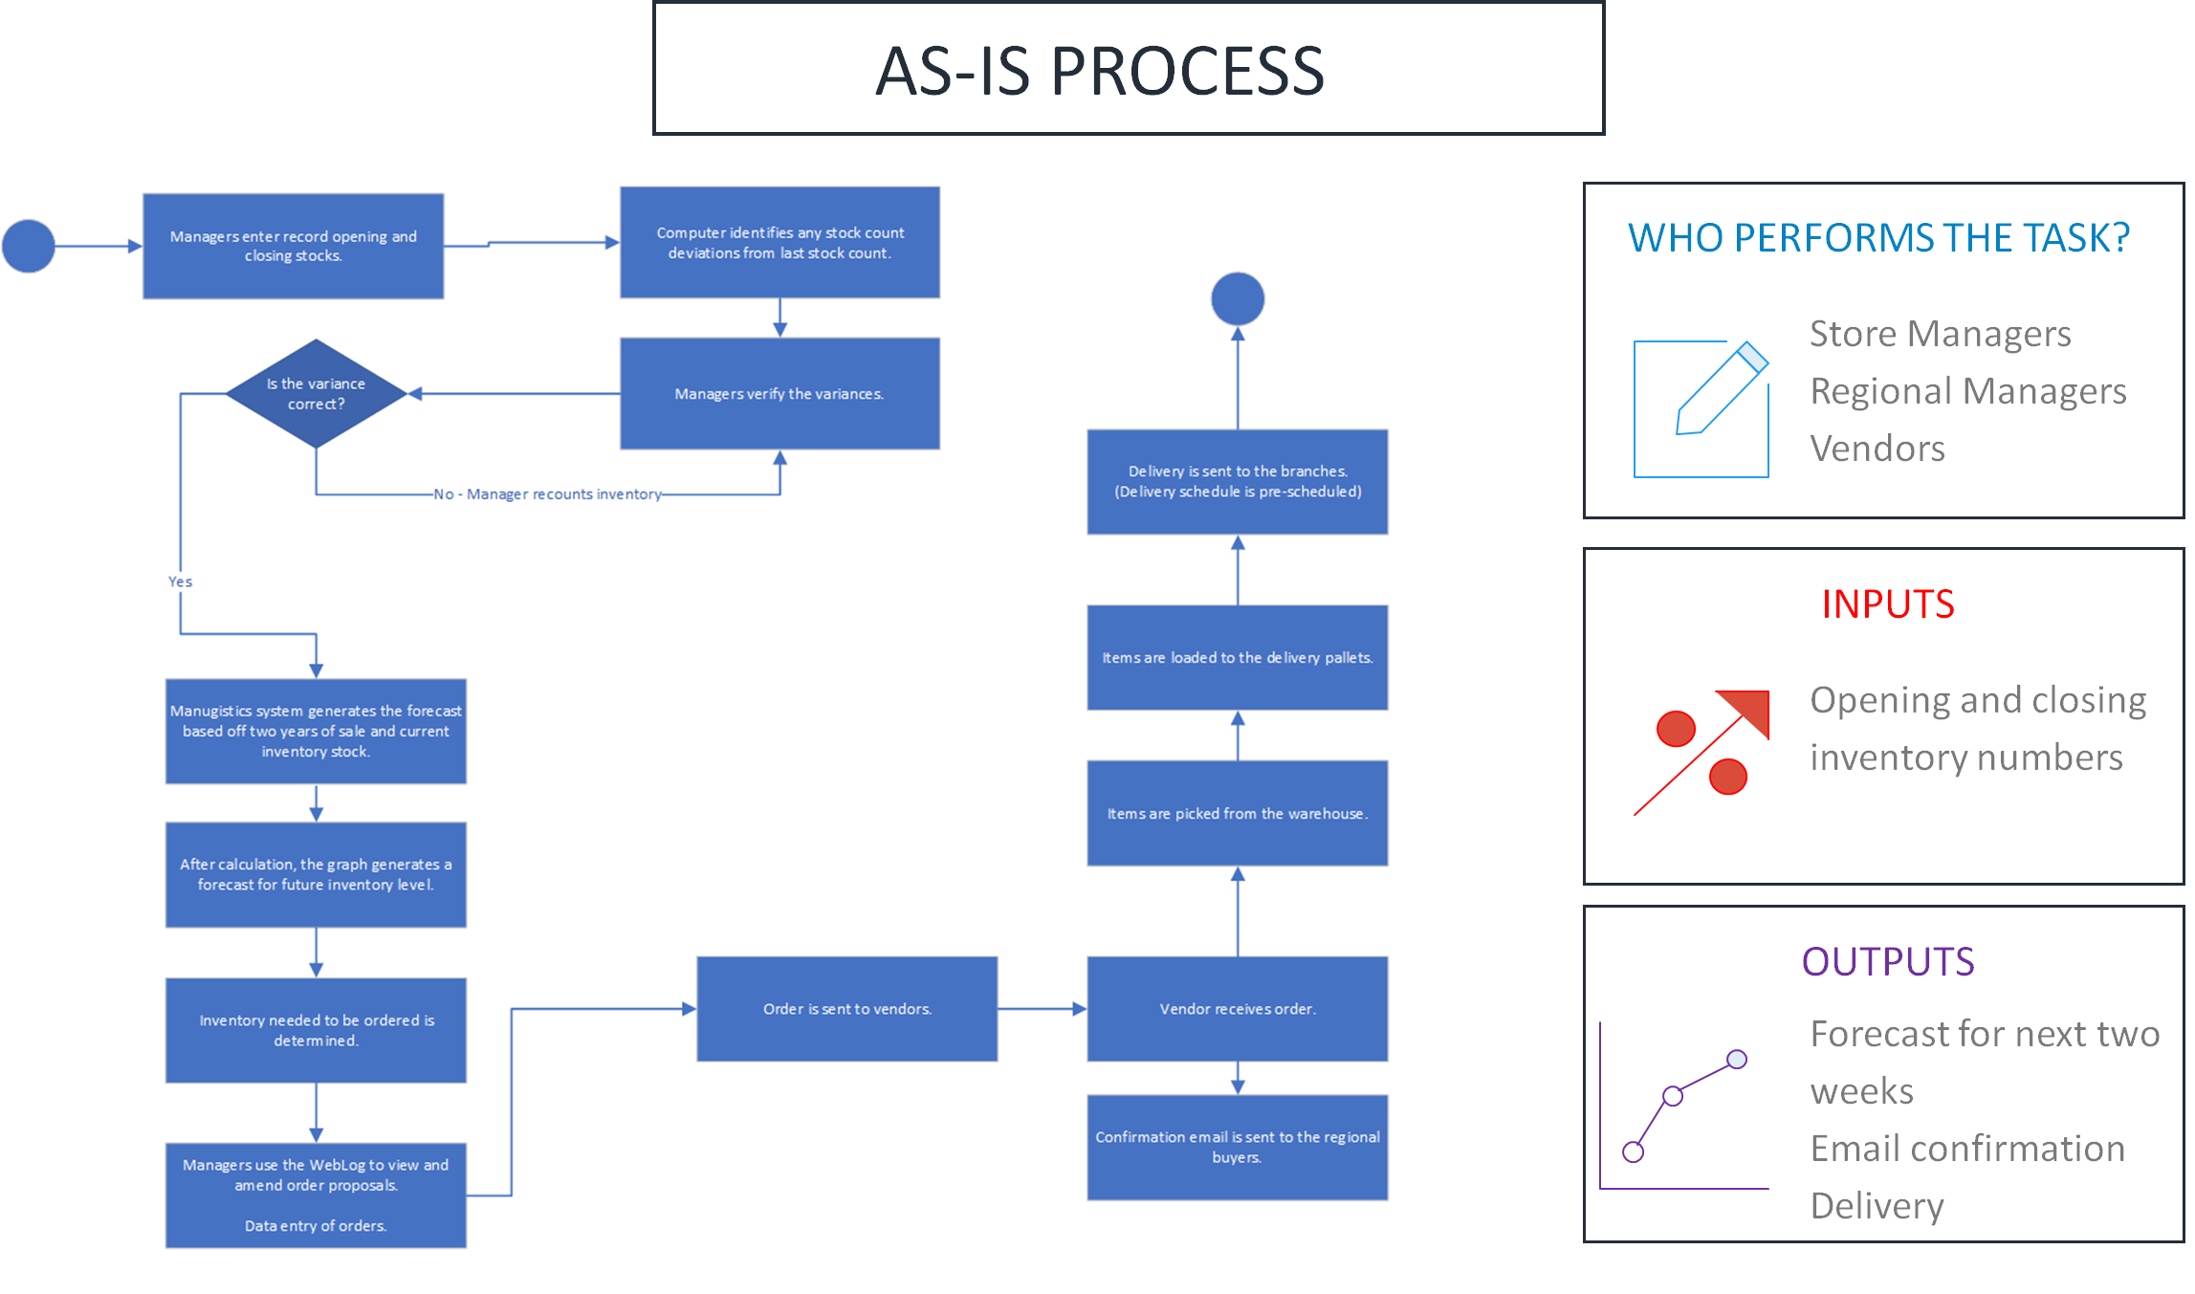
Notes:
➢ Describe the entire current process- Currently, managers have to take a physical count of inventory with the help of a current system but does not account for shrinkage and does not do it in real time
➢ Describe the problem areas of the current process that you plan to solve- We plan to solve the inefficient inventory forecasting which occurs at midnight everyday vs real time
➢ Why is the problem you identify an actual problem
Wastes money

Slide 4
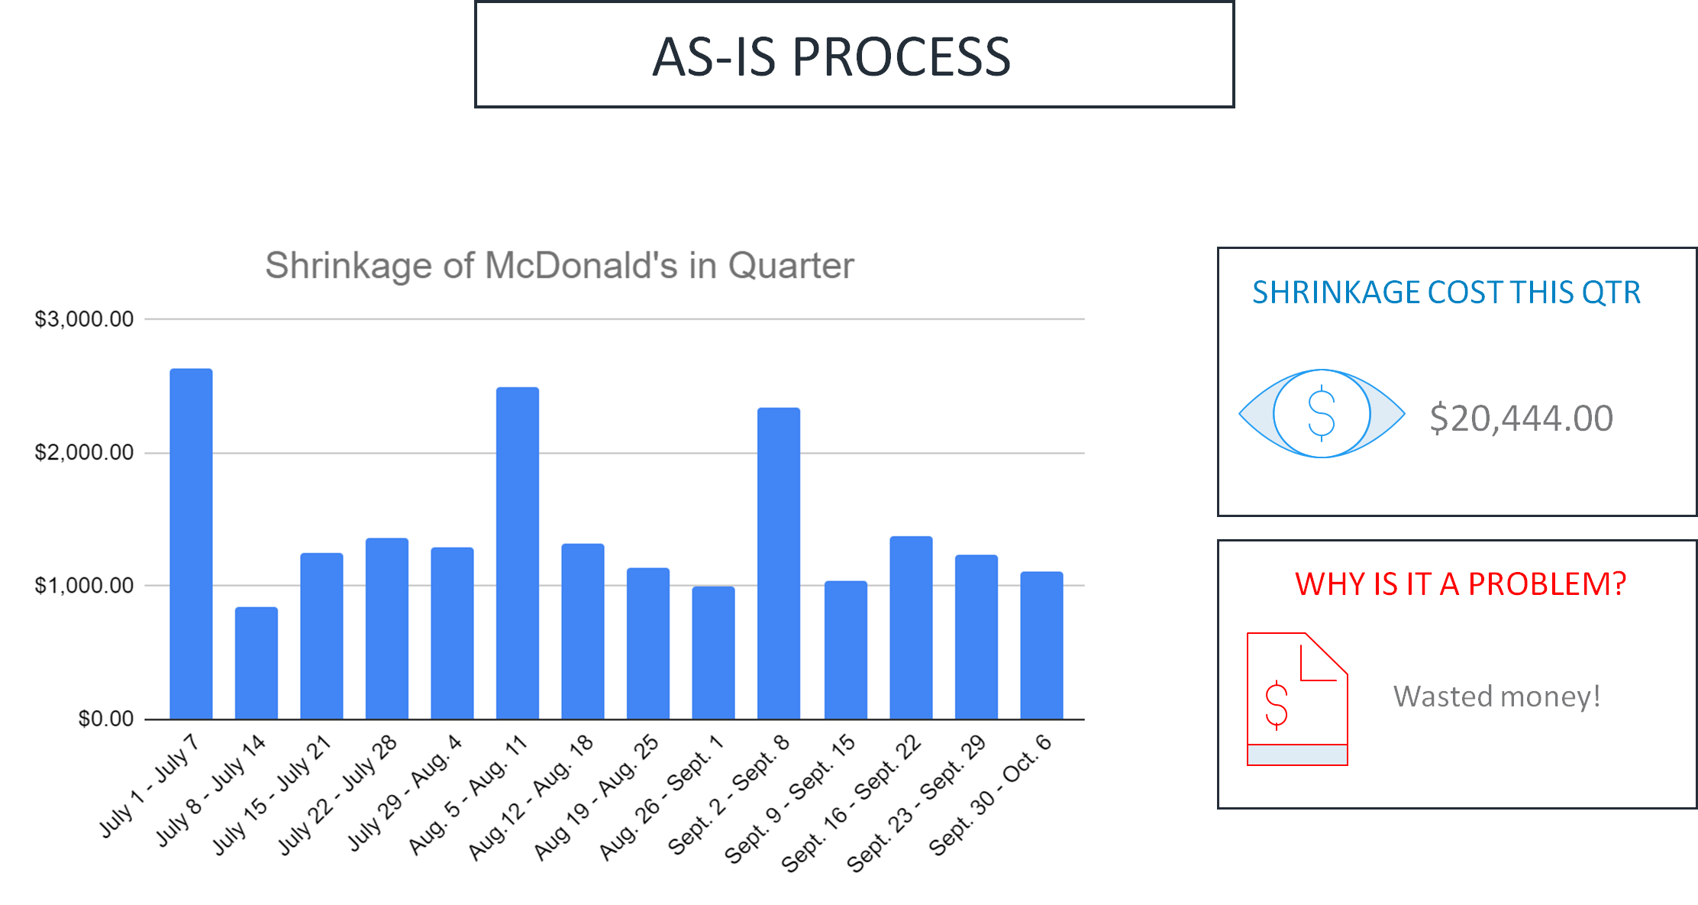
Notes:
Quarterly graph of shrinkage and money wasted

Slide 5
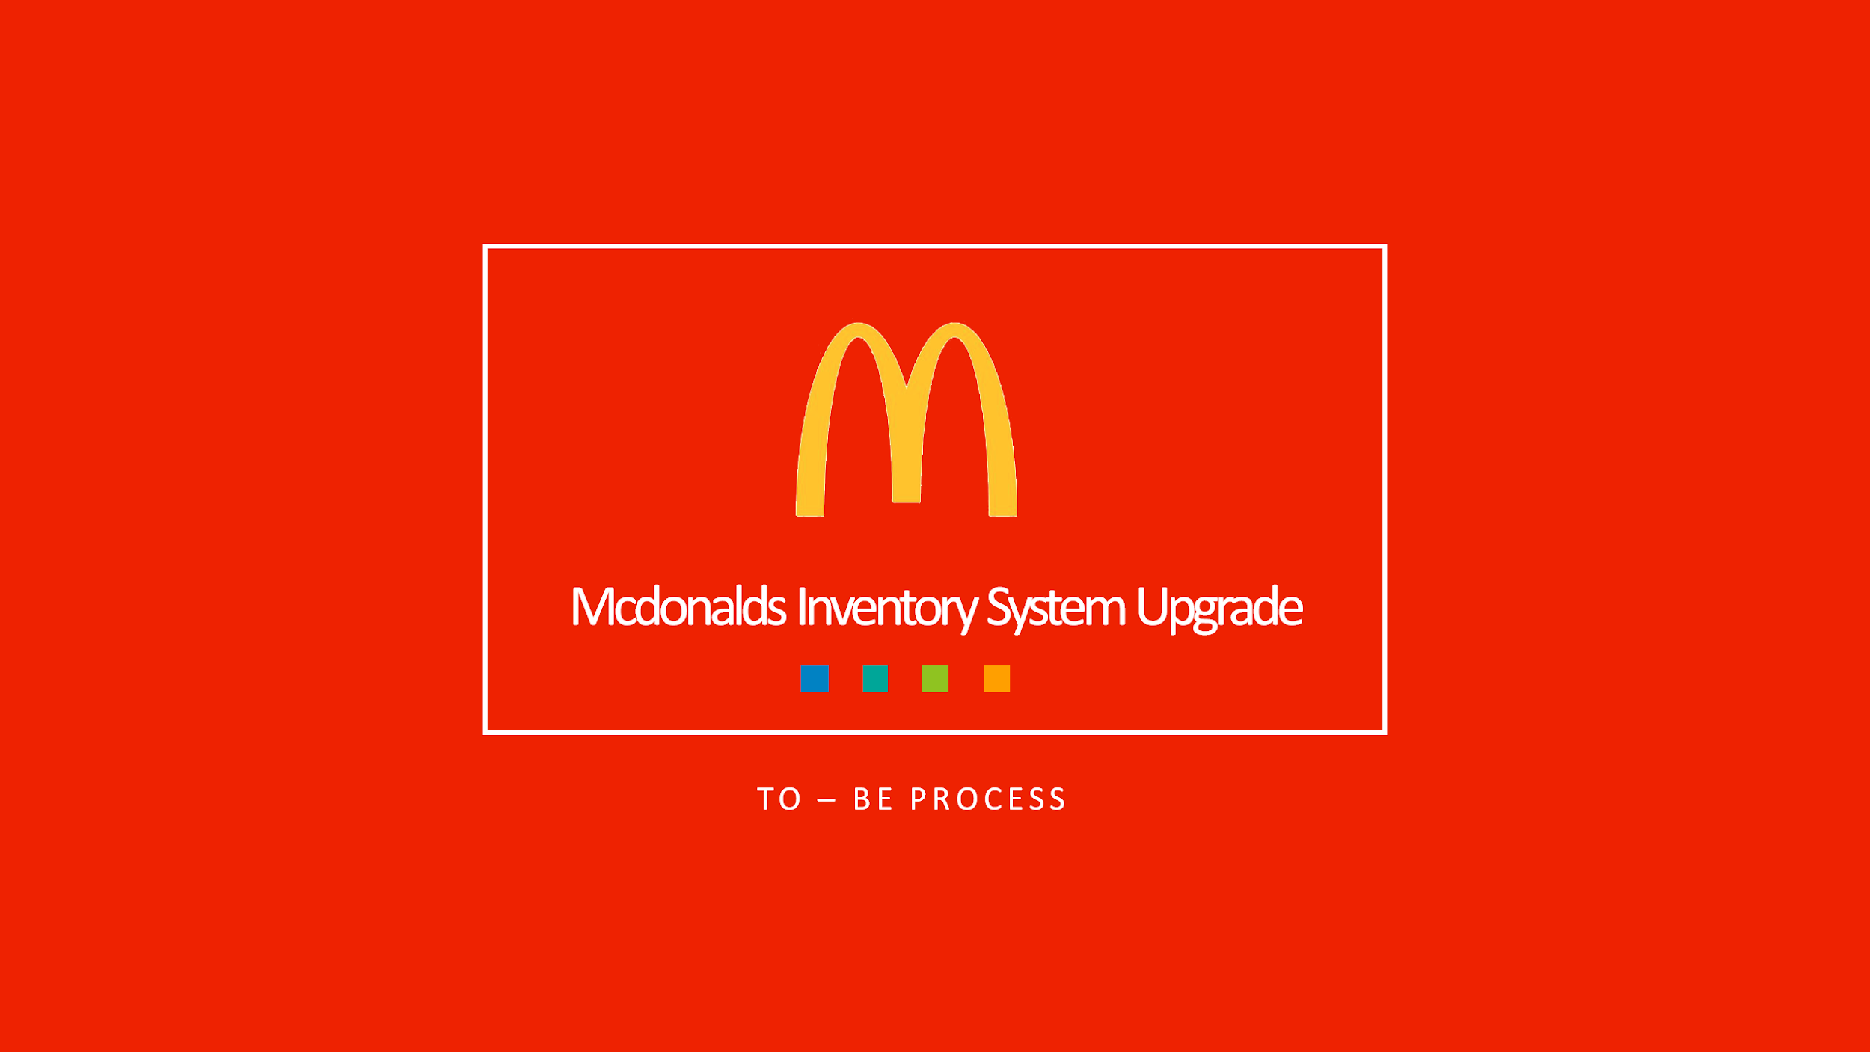

Slide 6
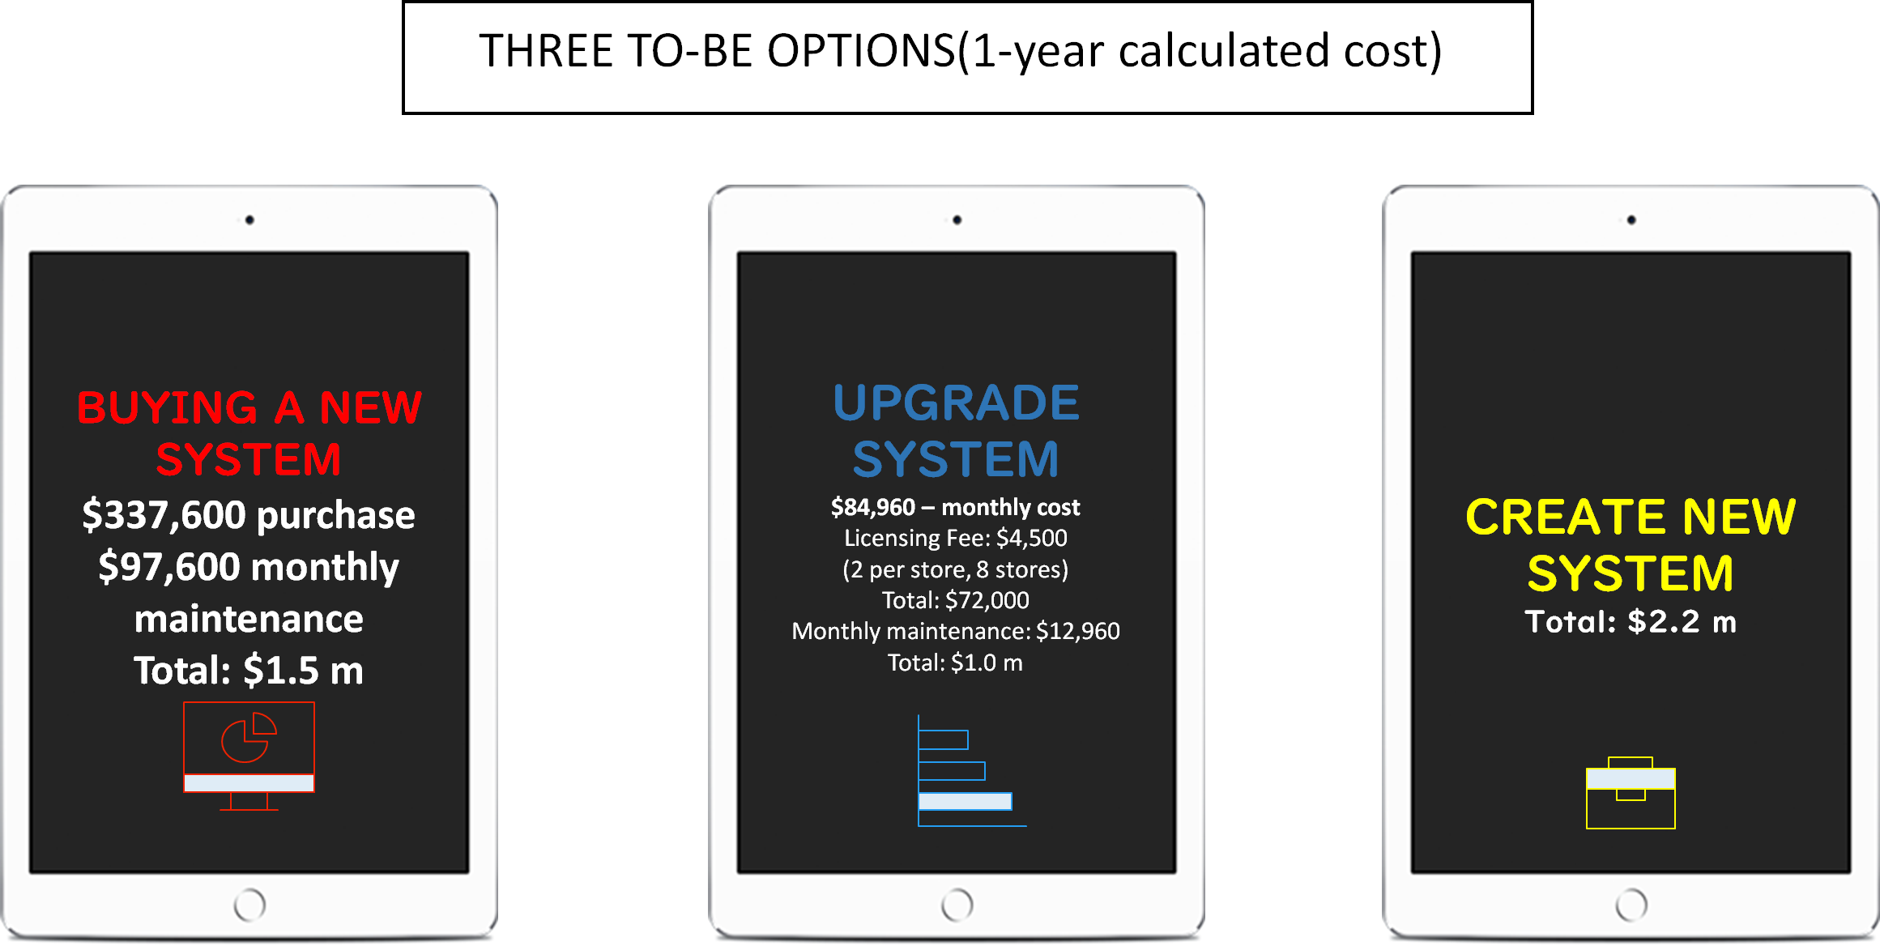
Notes:
➢ Layout the options that are available to the organization as solutions
Buying new system, upgrade current system, create a new system; It did not make sense to buy or create a whole system when we liked the previous system, but just wanted to add one thing

Slide 7
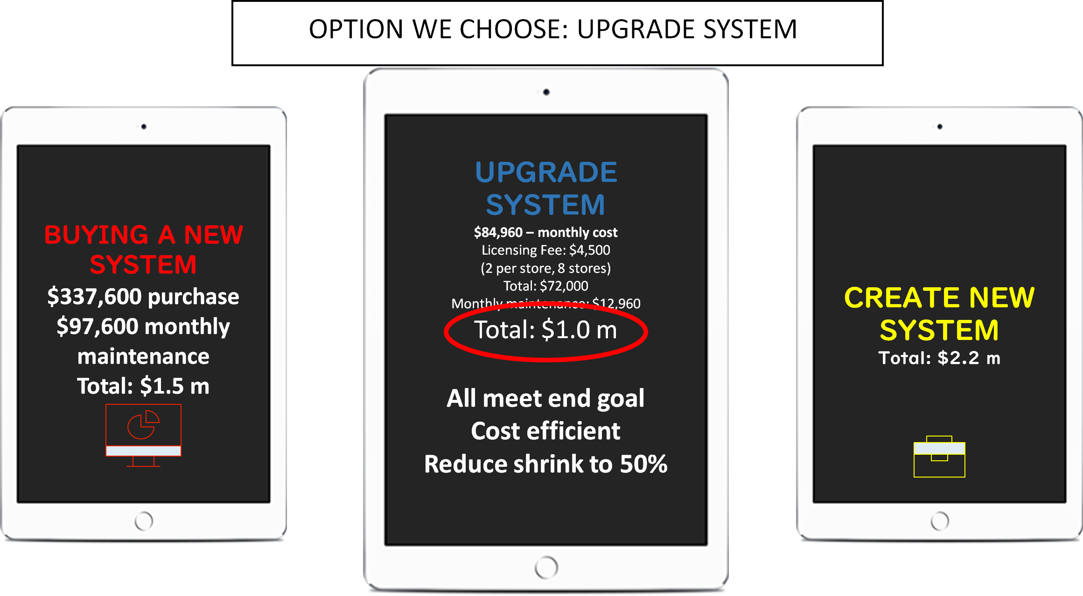
Notes:
➢ Show the best solution (recommended) for the organization to adopt
Upgrade system- it meets all the goals, cost efficient, and reduces shrinkage by 50%

Slide 8
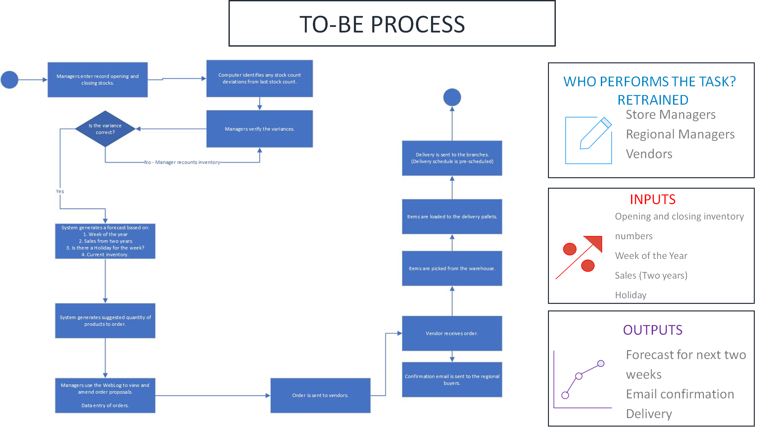
Notes:
The change in the system is real time updating with the upgrade

Slide 9
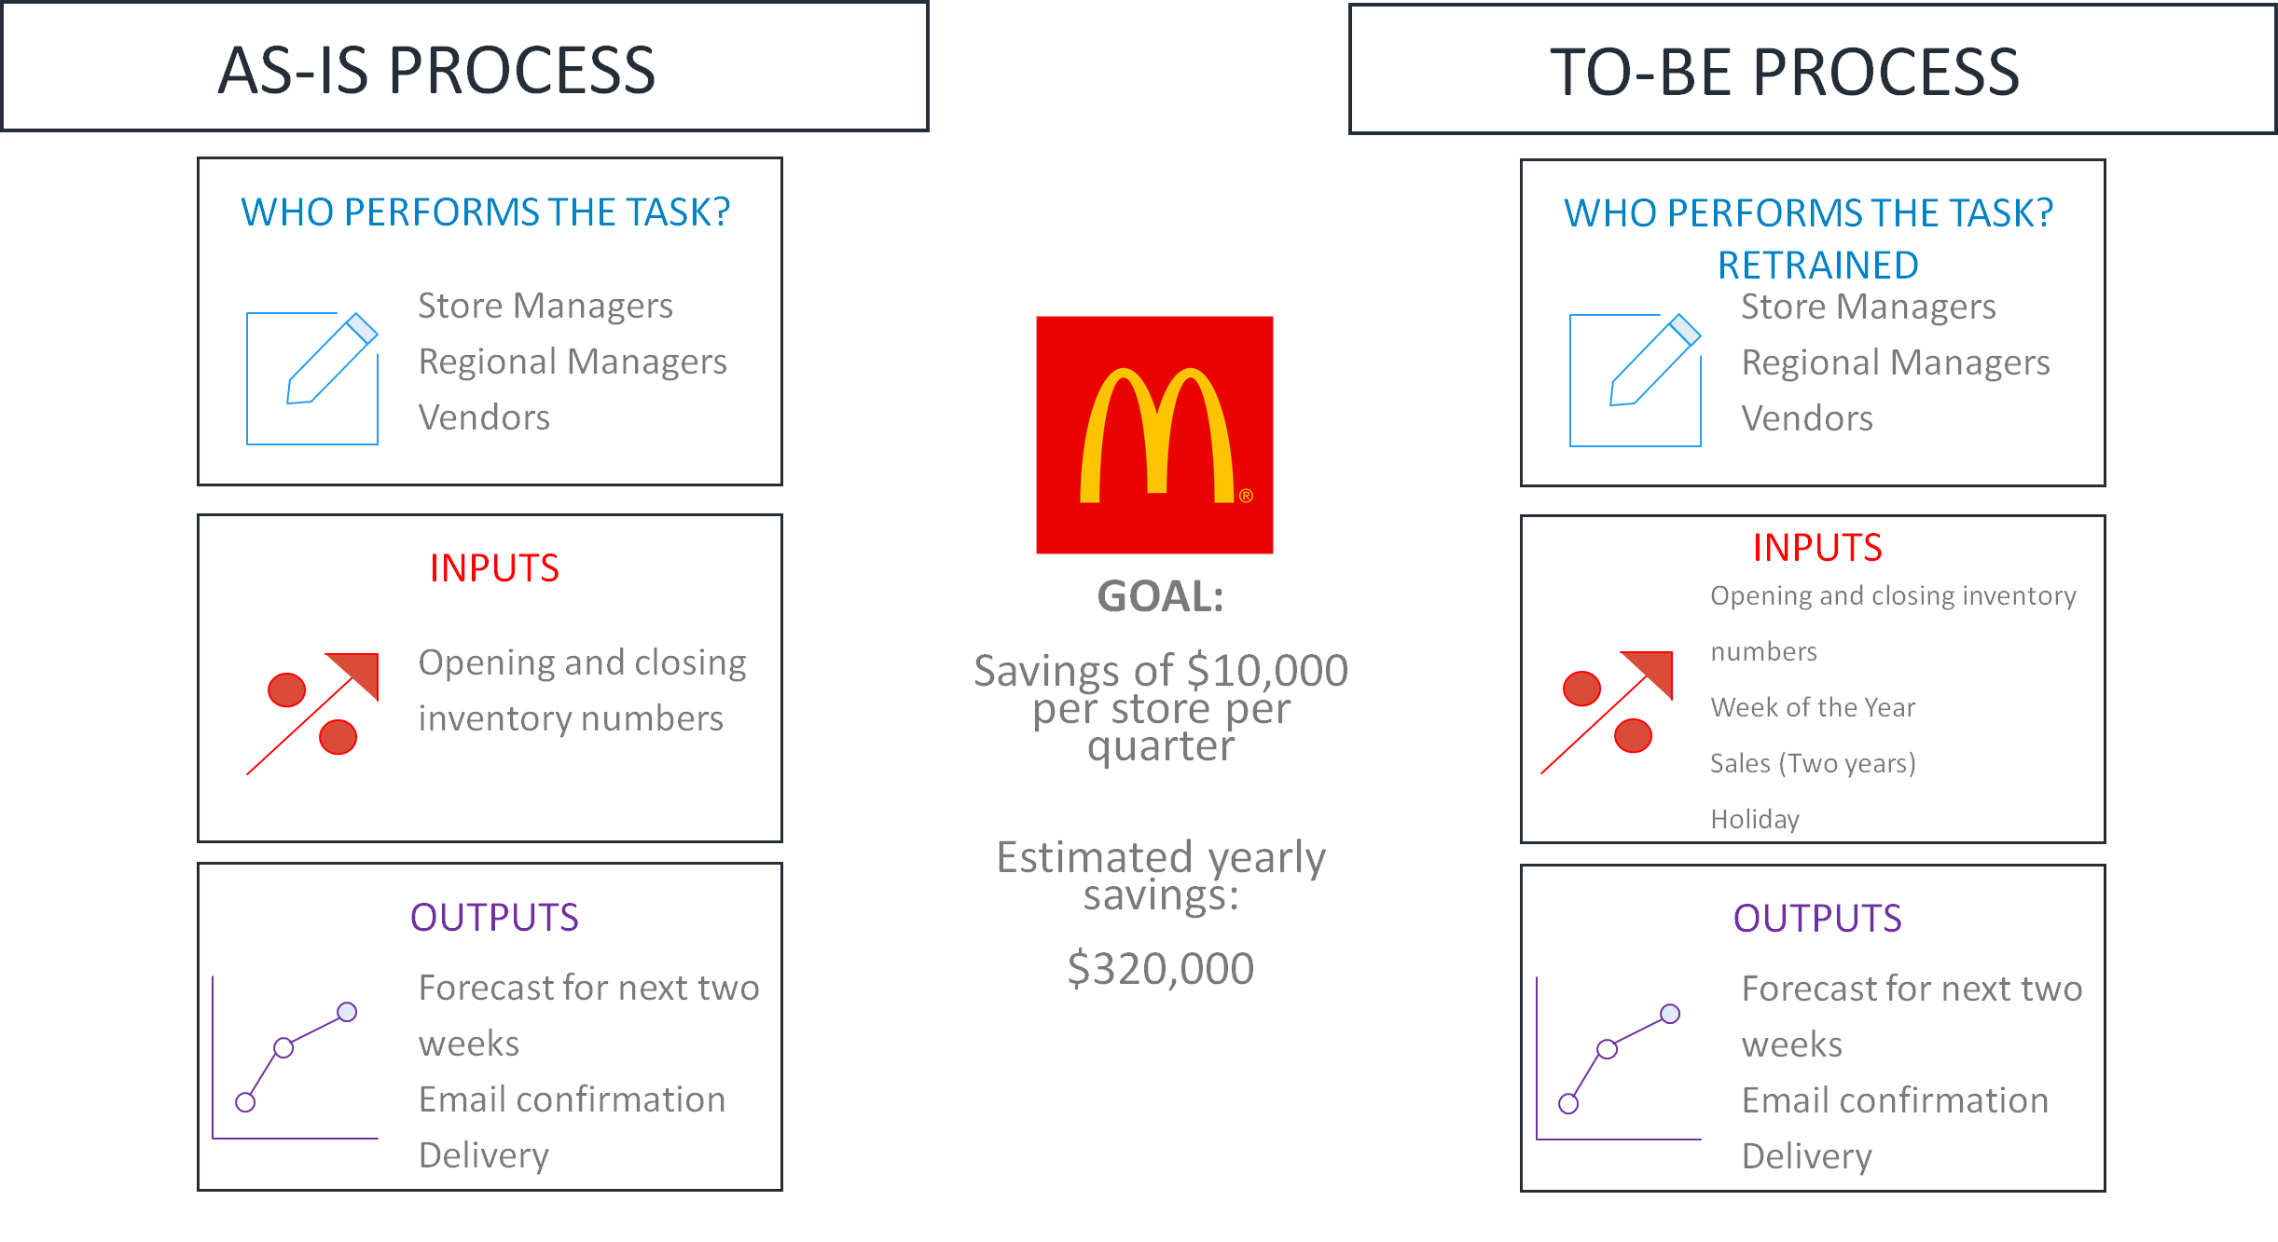

Slide 10
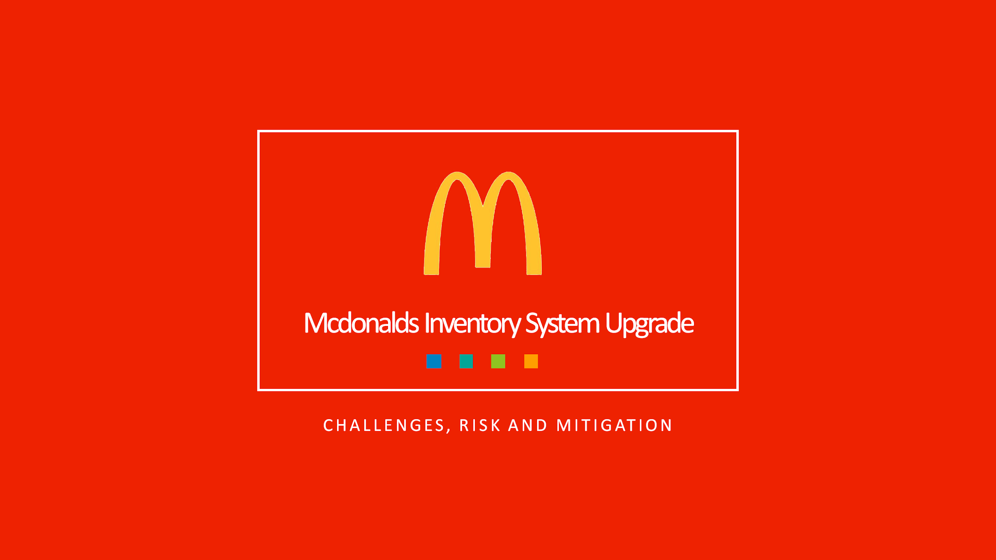

Slide 11
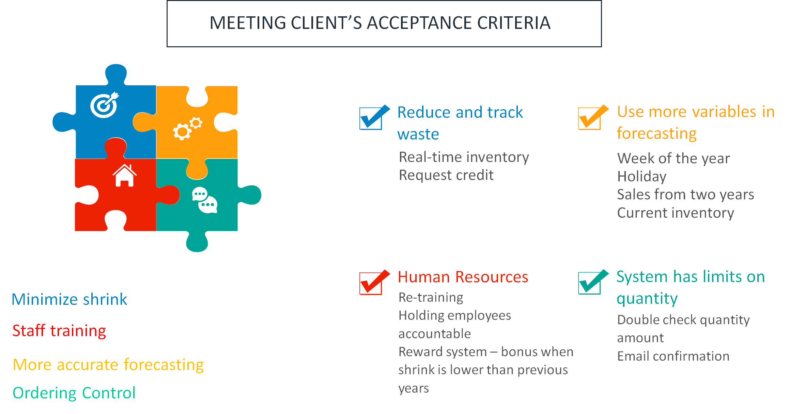

Slide 12
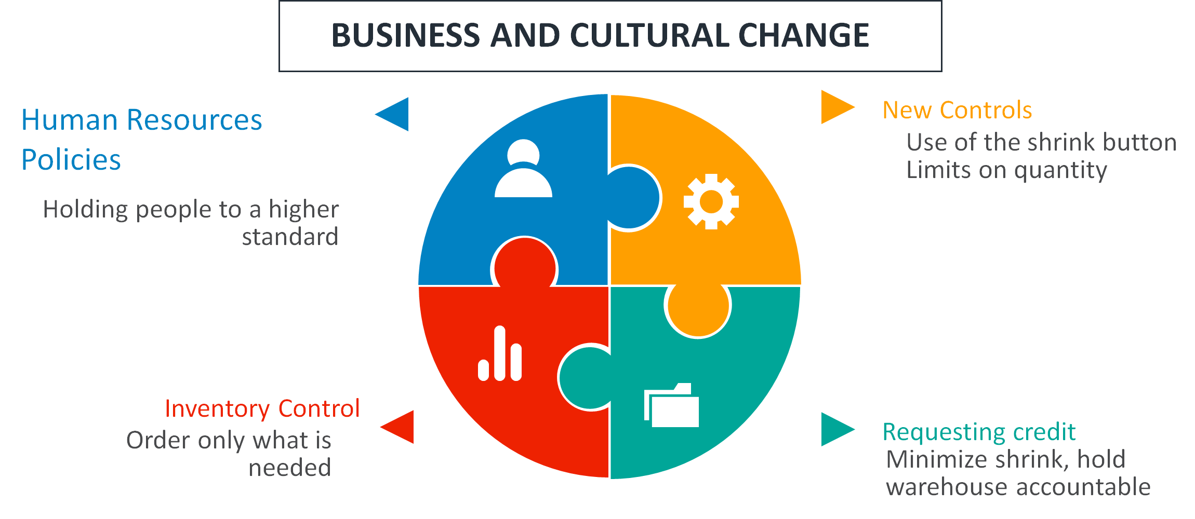

Slide 13

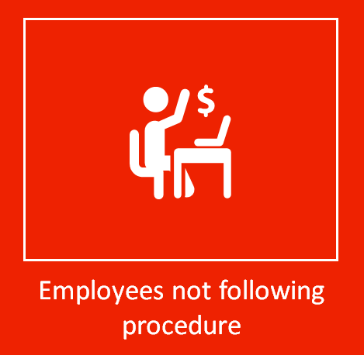

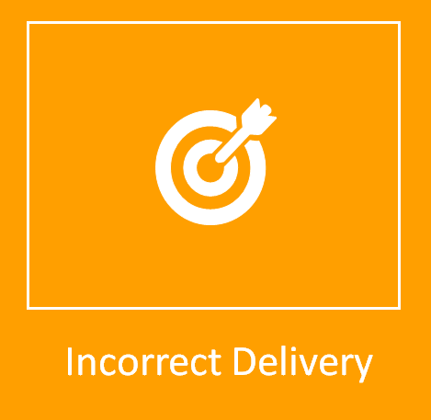


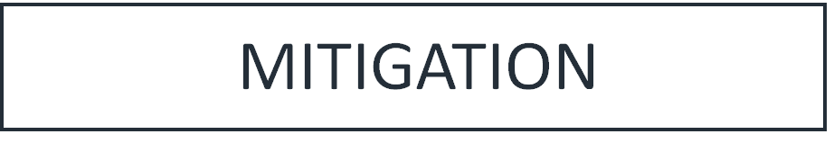
Employee Training
Accountability
Security Cameras
Offline Backup server
Email confirmation
Check-in during delivery
Request credit
Profitability
Store savings
Closely monitor on-hands
Reduce labor cost
Insurance

Slide 14
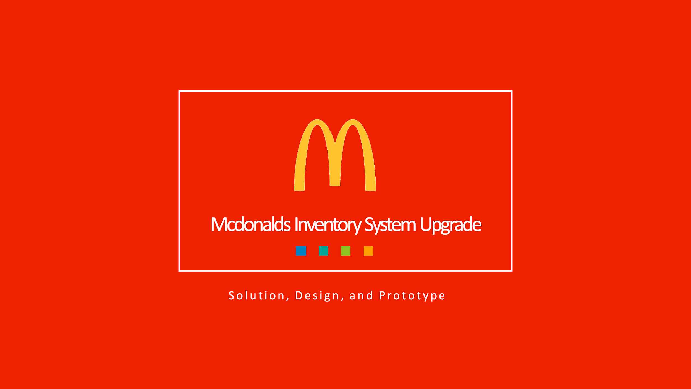

Slide 15
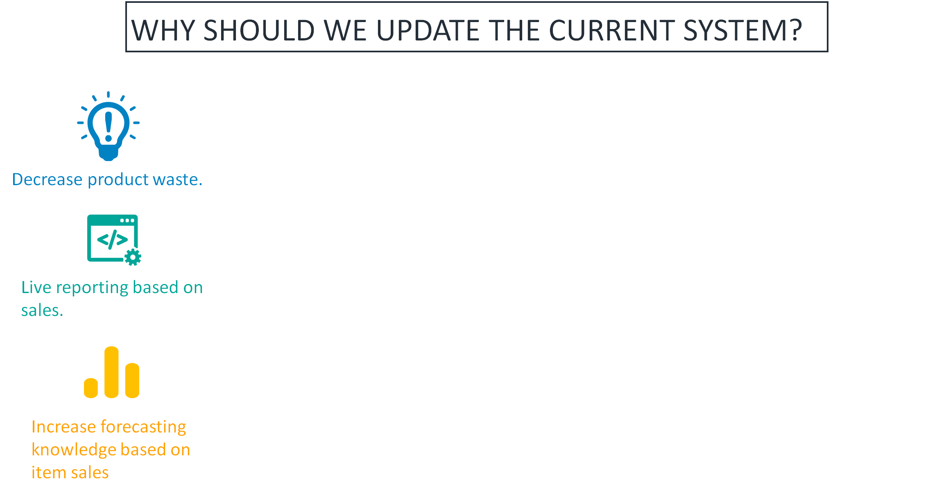
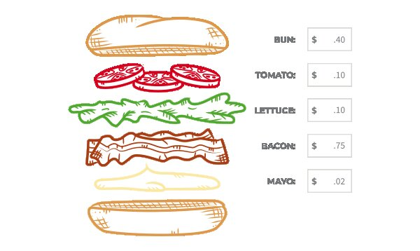
Notes:
Quick recap - we are updating the system to decrease waste, live reporting based on sales, increased knowledge based on forecasting

Slide 16
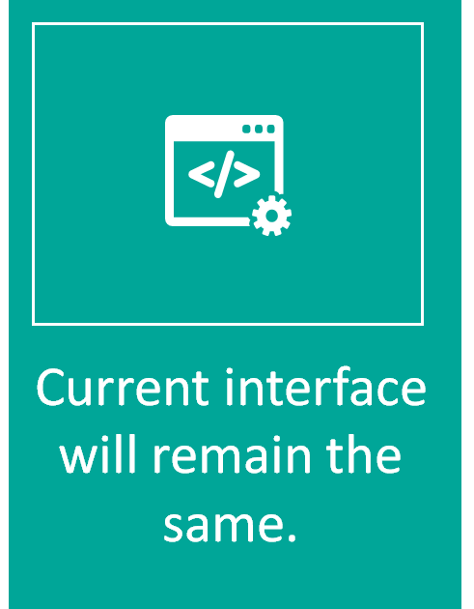
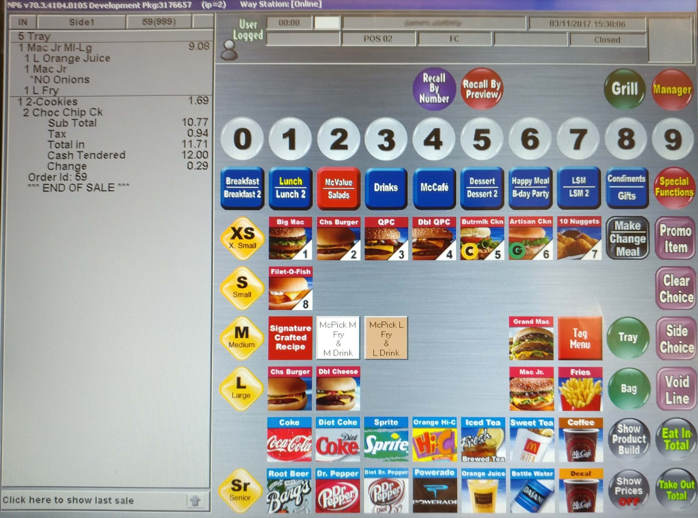
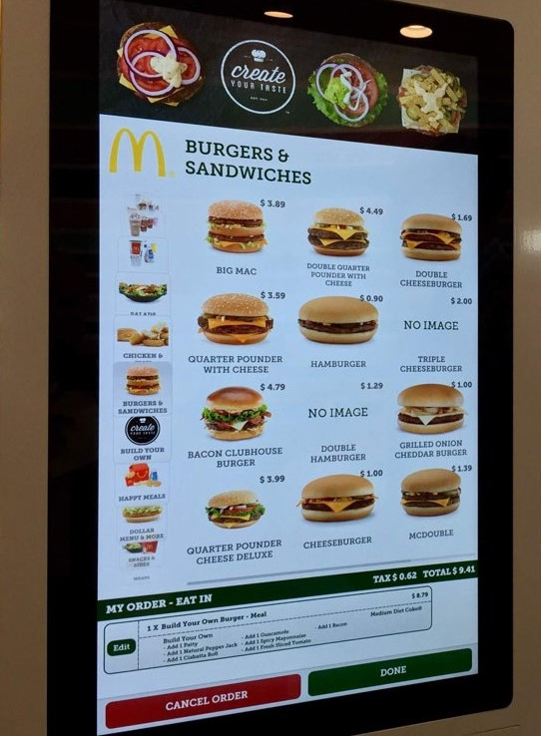
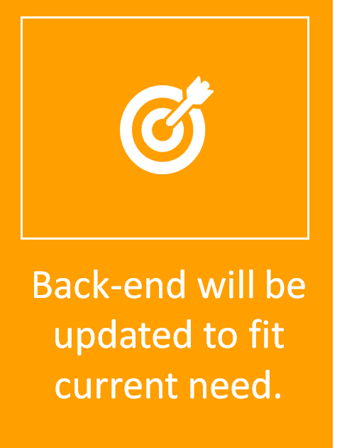
Notes:
This is the interface that people see: Left side is register and right side is kiosk does not change for employee or customer; we are just updating the back end

Slide 17
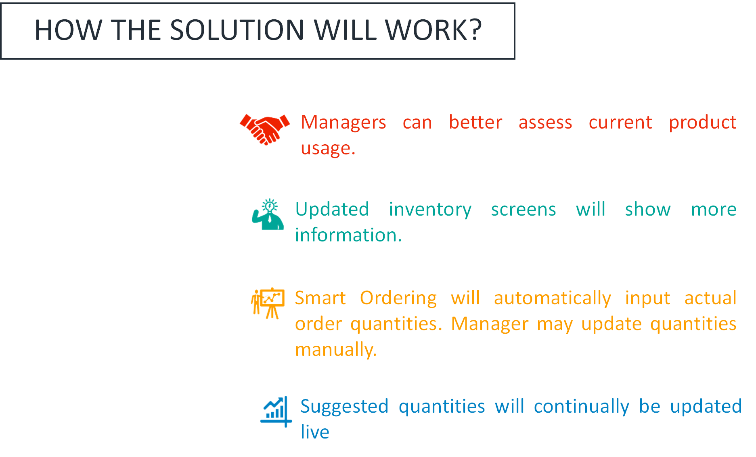
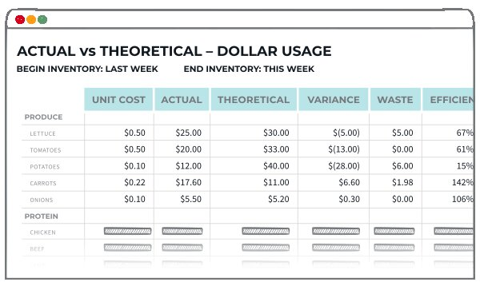
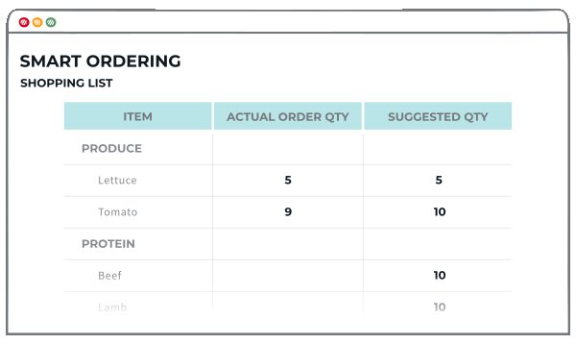
Notes:
Management interface on left, Managers can see more real time information, managers can update this , suggested quantities for future orders

Slide 18
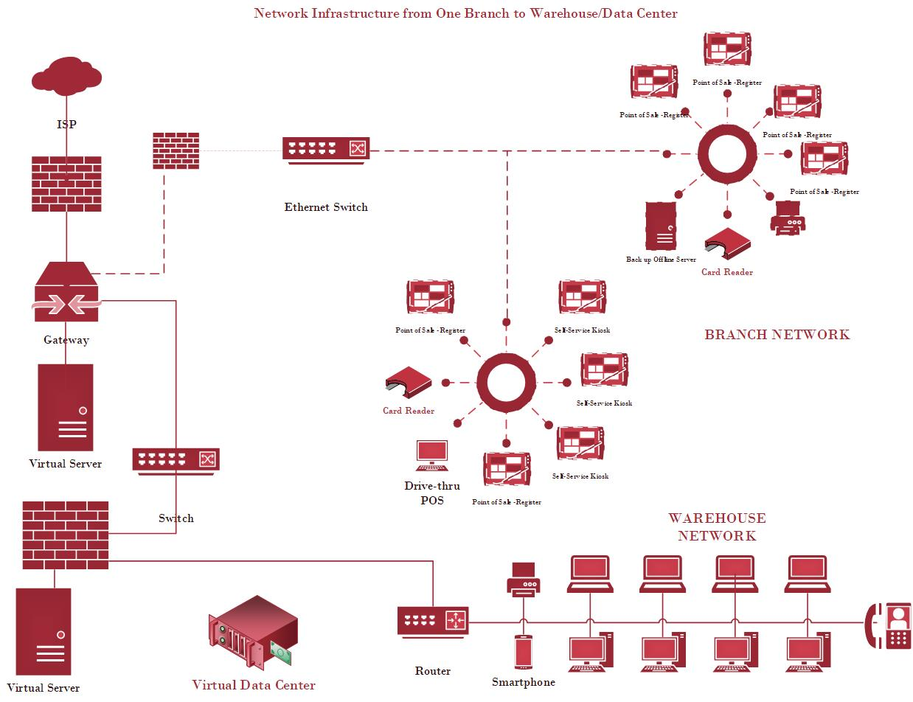
Notes:
Networking- how everything is
Internet is connected to a gateway through a firewall that connects the stores through a ethernet switch
Showcasing two branches which has card reader, kiosks and register and backup server
From gateway we use another switch that connects the warehouse’s virtual server, and that warehouse is what stores use to get data if needed

Slide 19
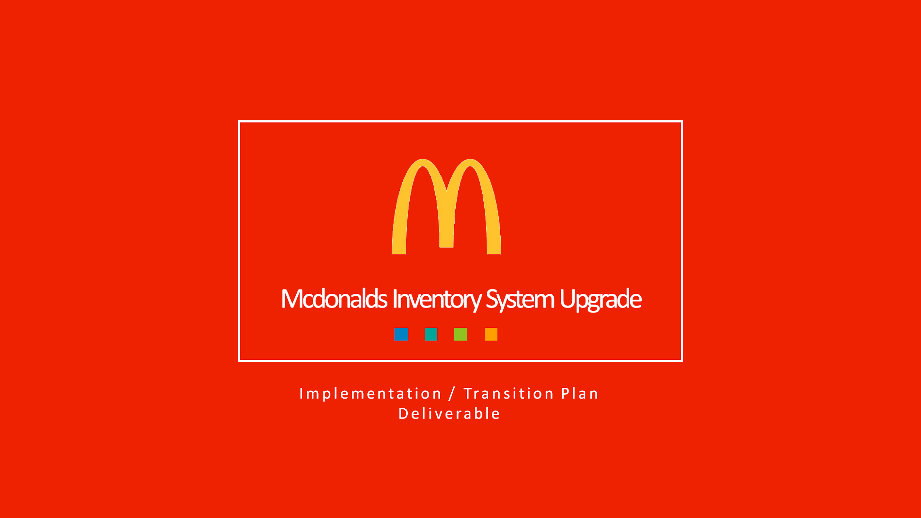

Slide 20
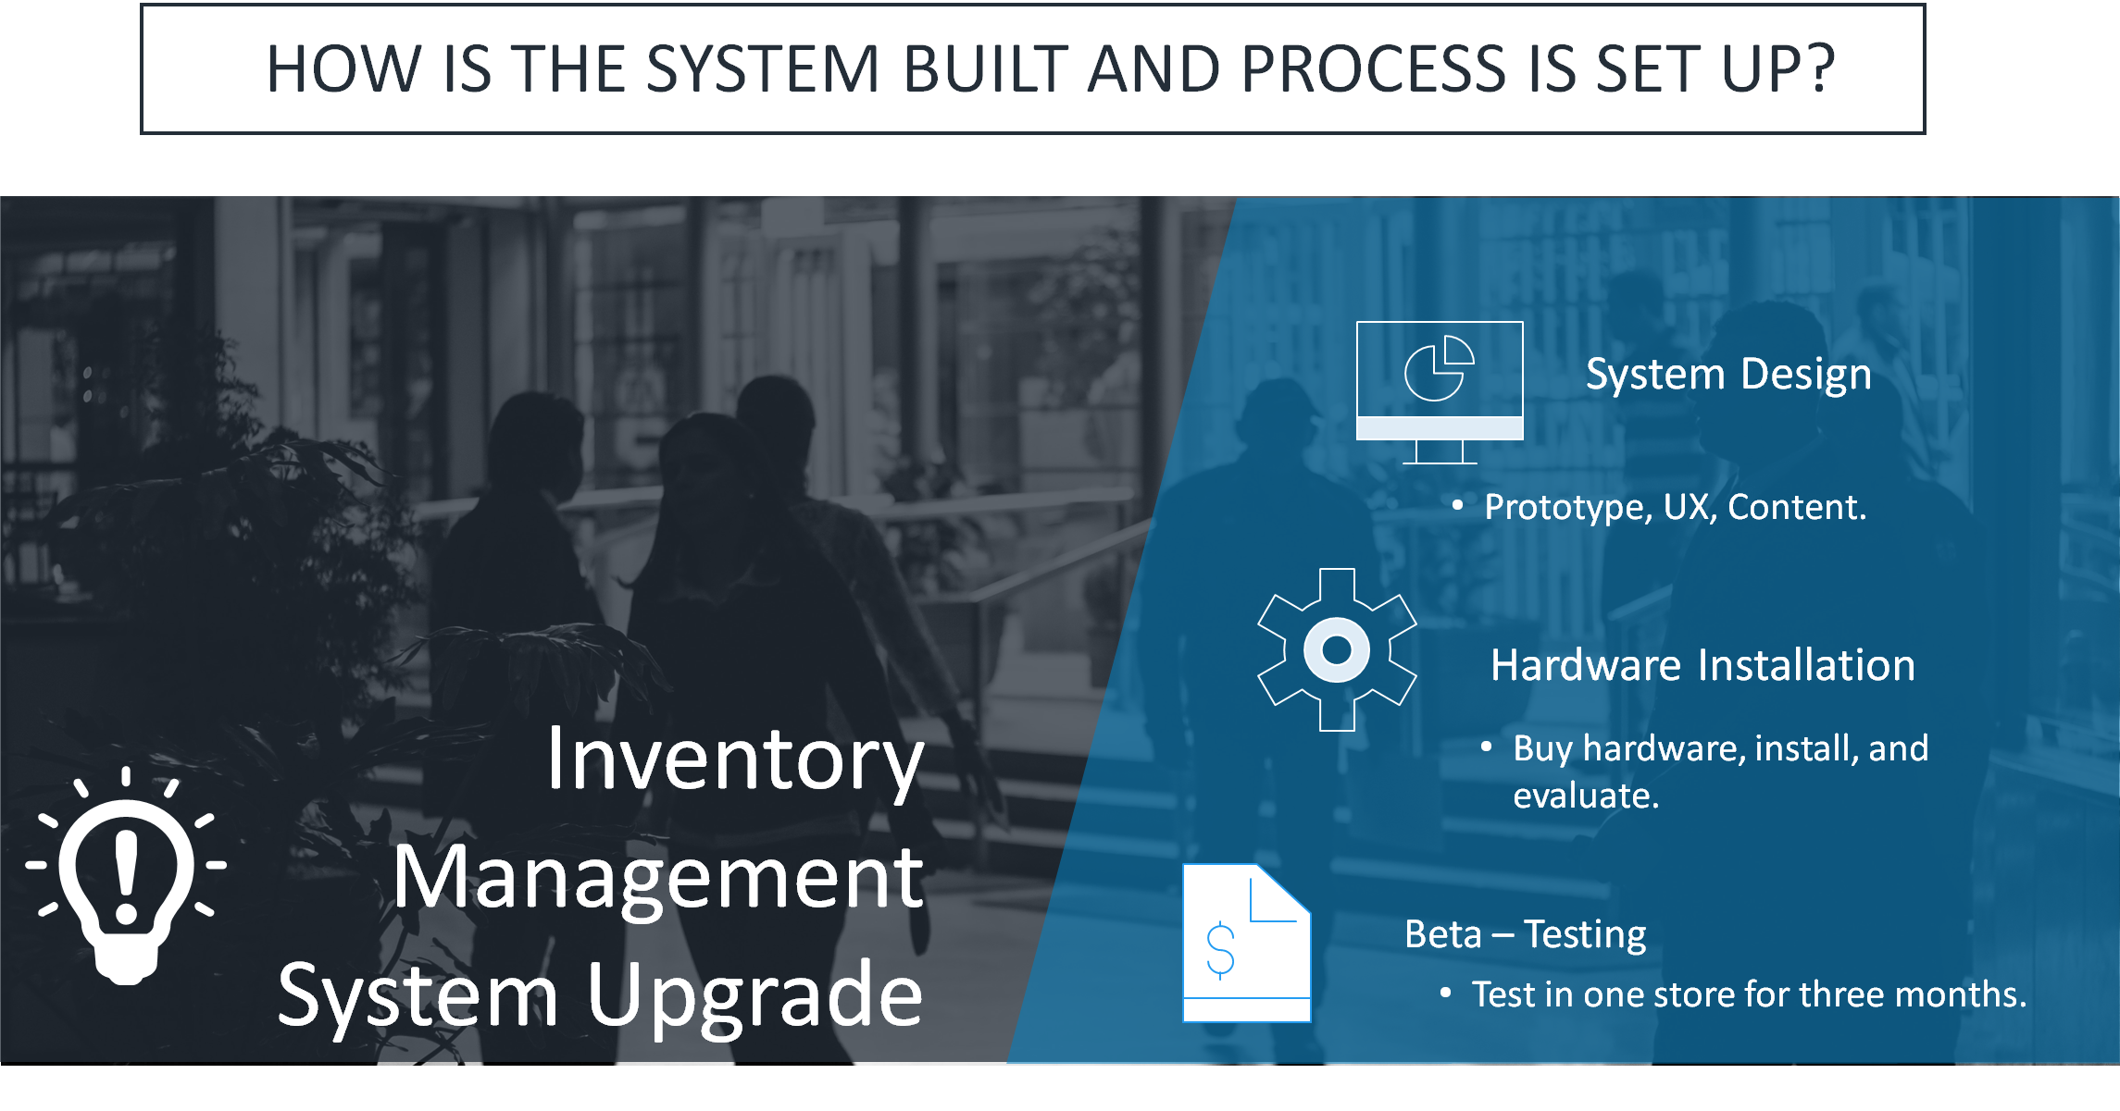
How the system is built and process is set up

Slide 21
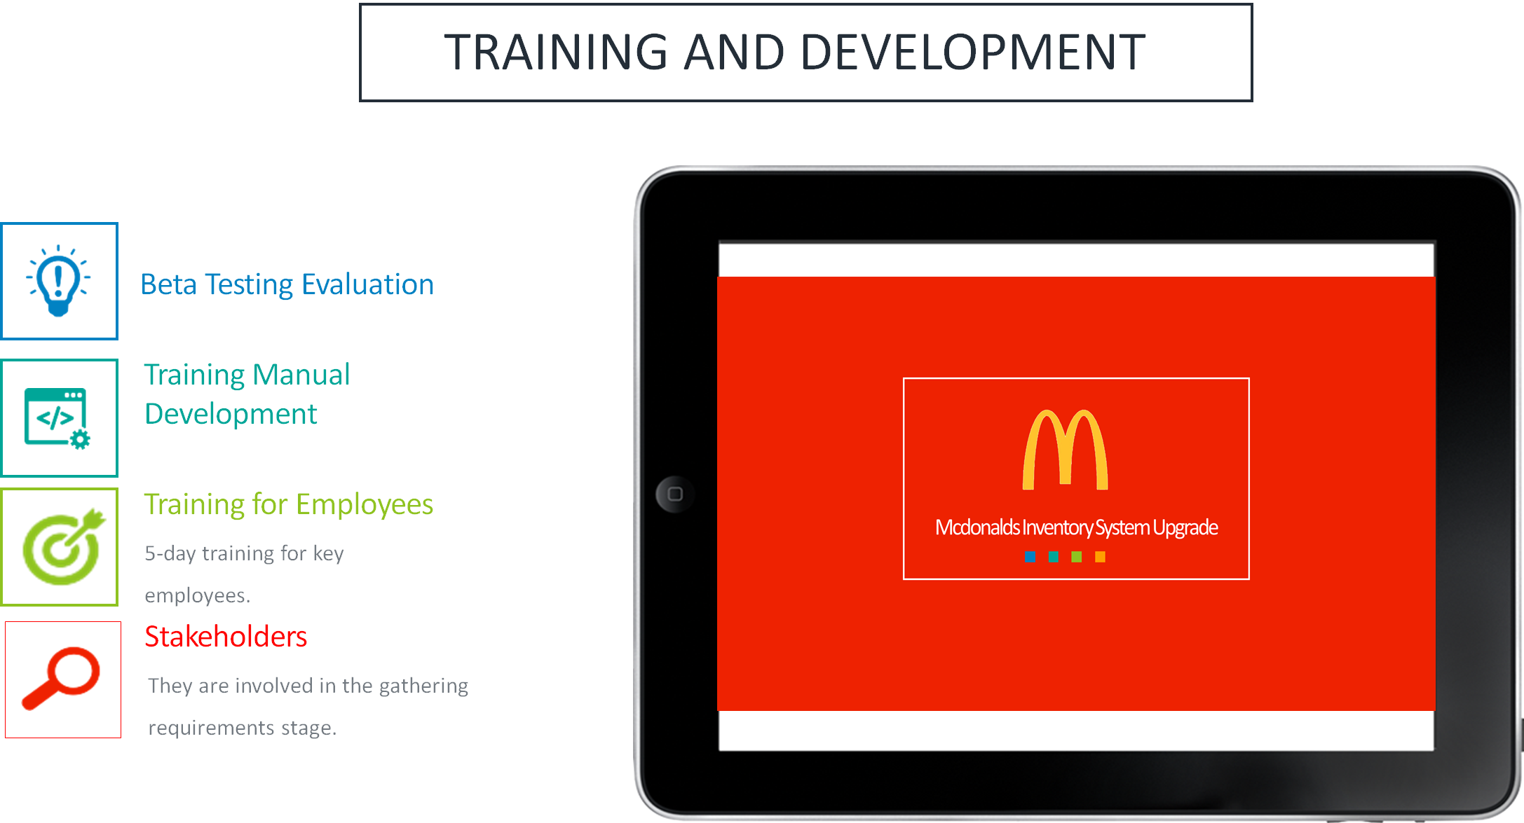
Informing and Training the Team, Users, and Other Stakeholders

Slide 22
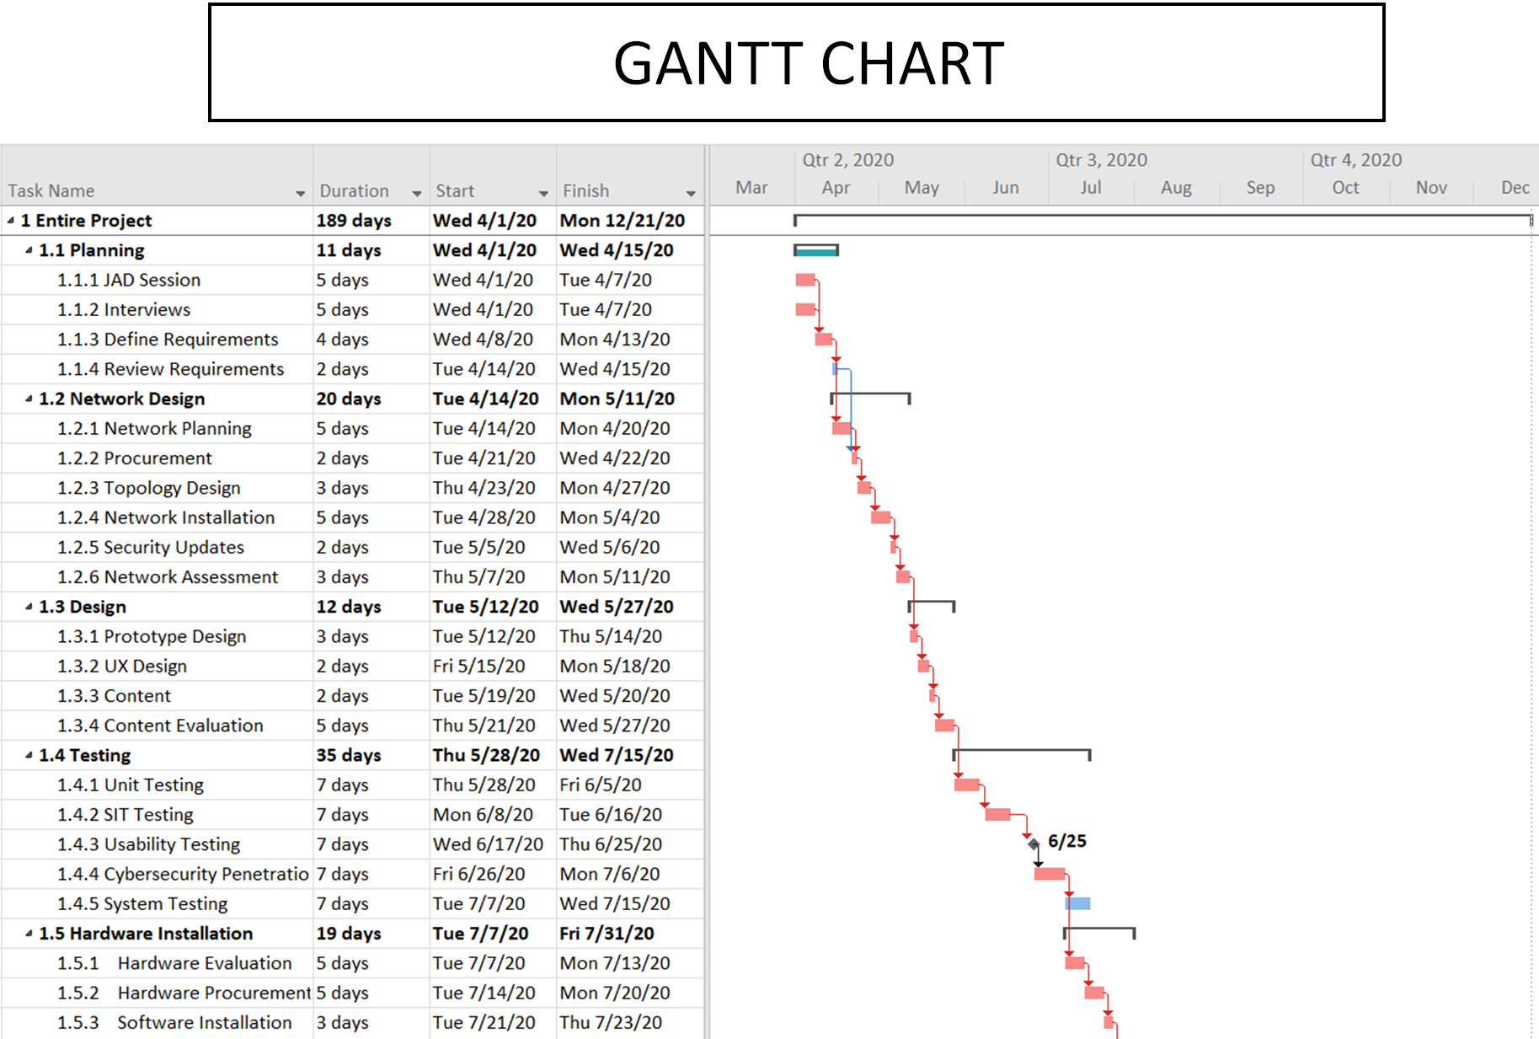

Slide 23
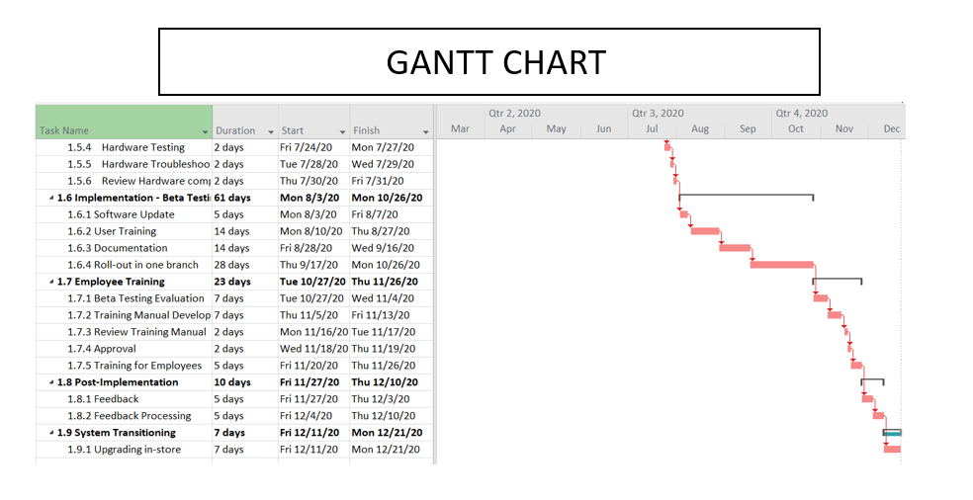

Slide 24
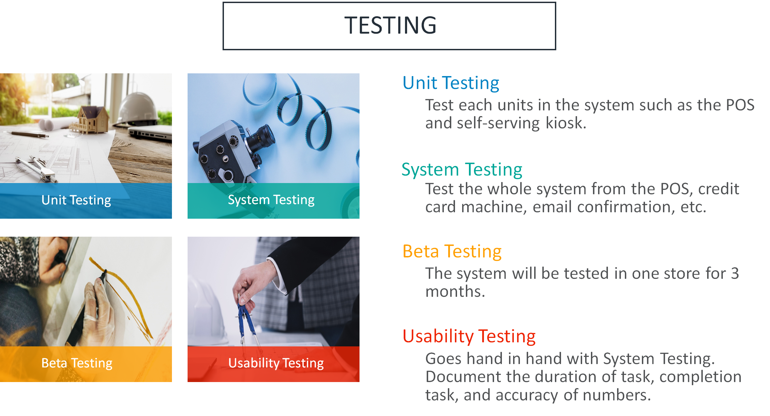

Slide 25
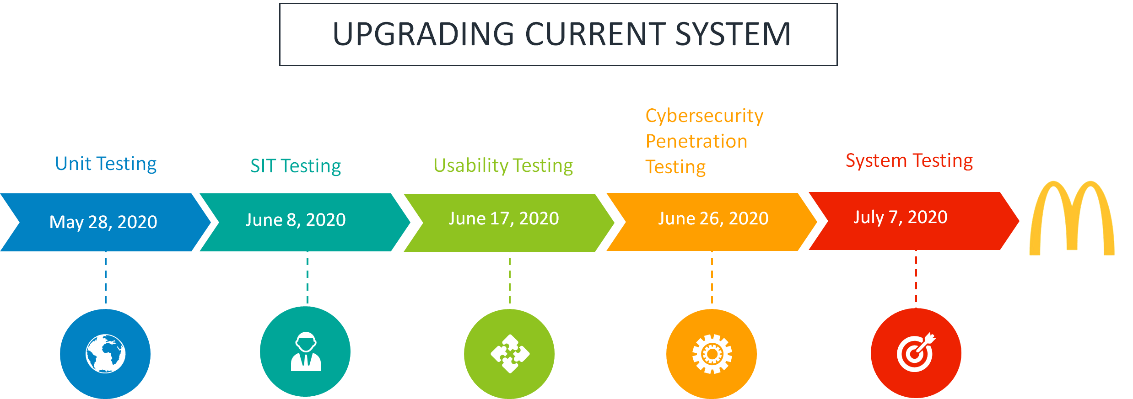

Slide 26
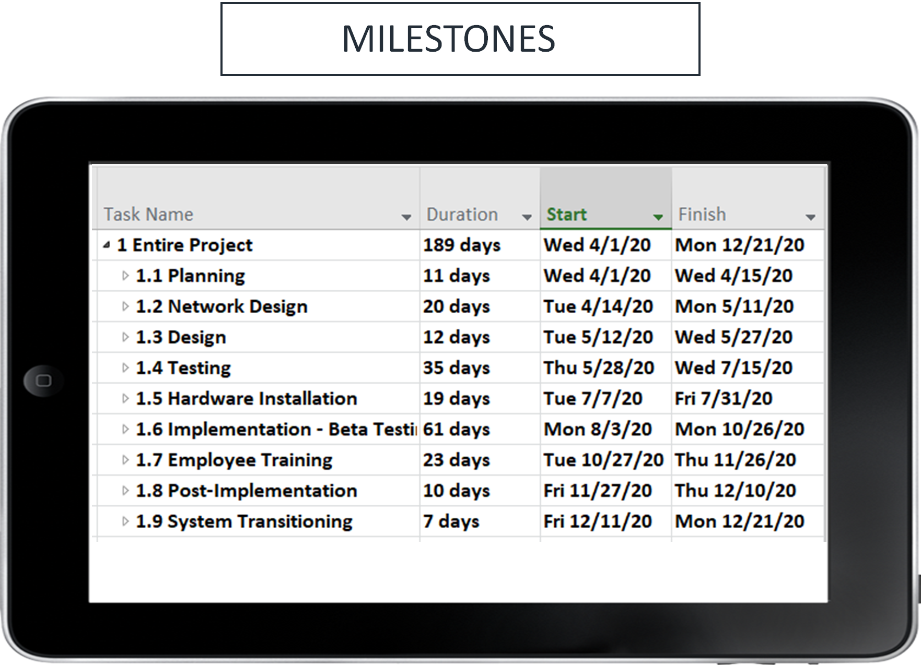

Slide 27
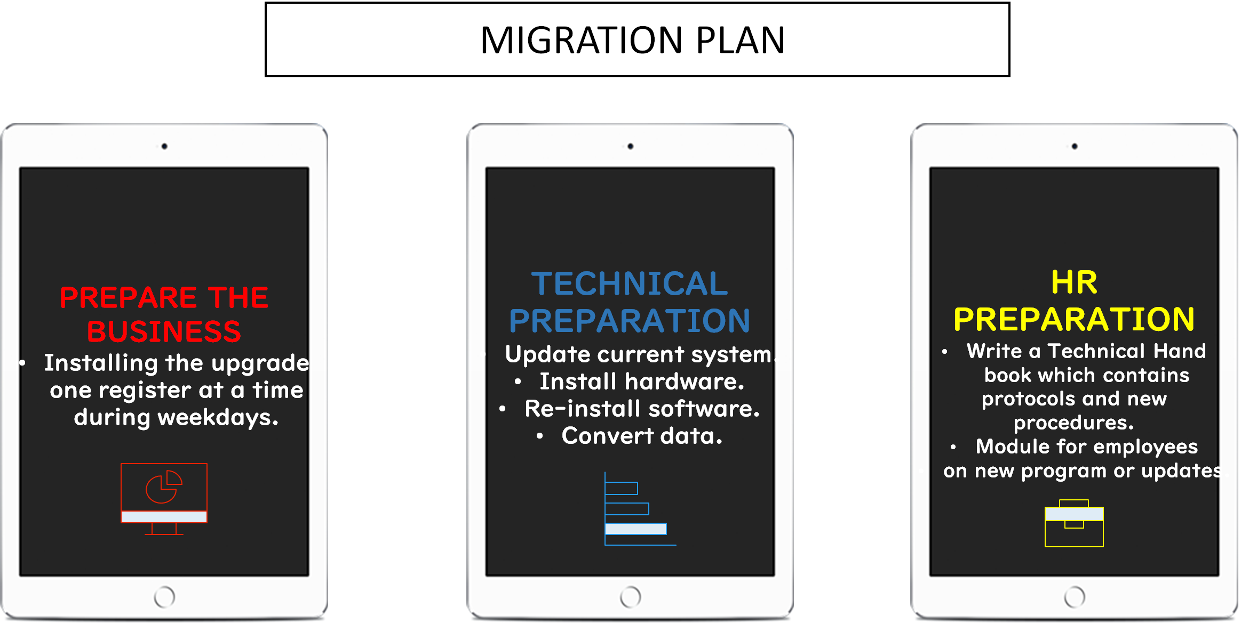
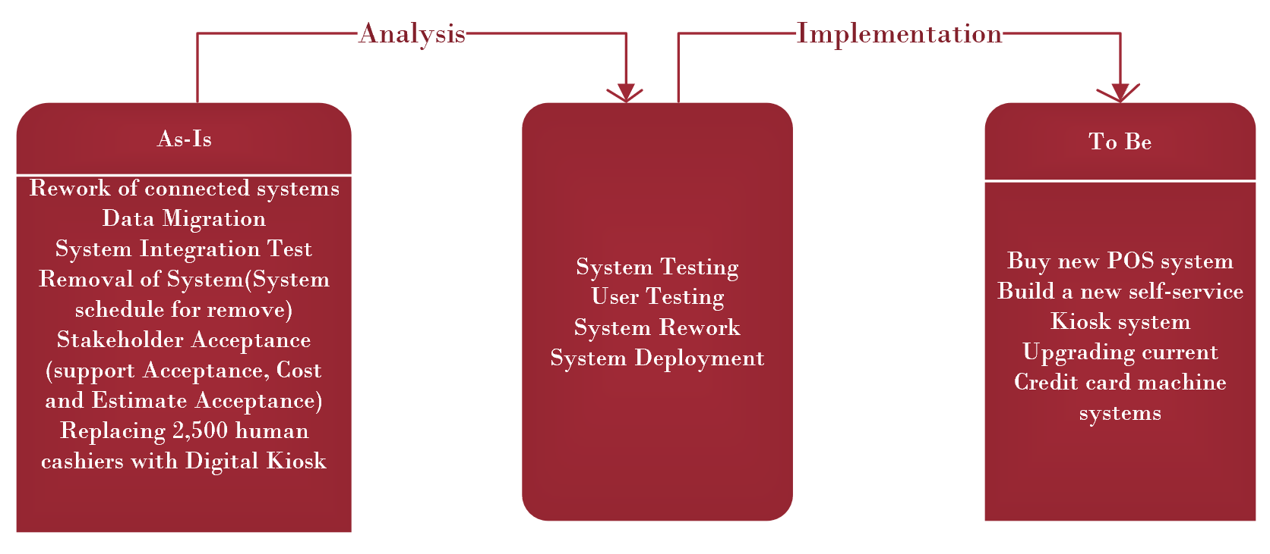
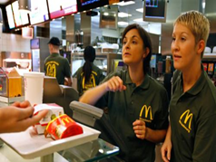
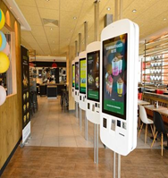
TRANSITION PLAN

Slide 28
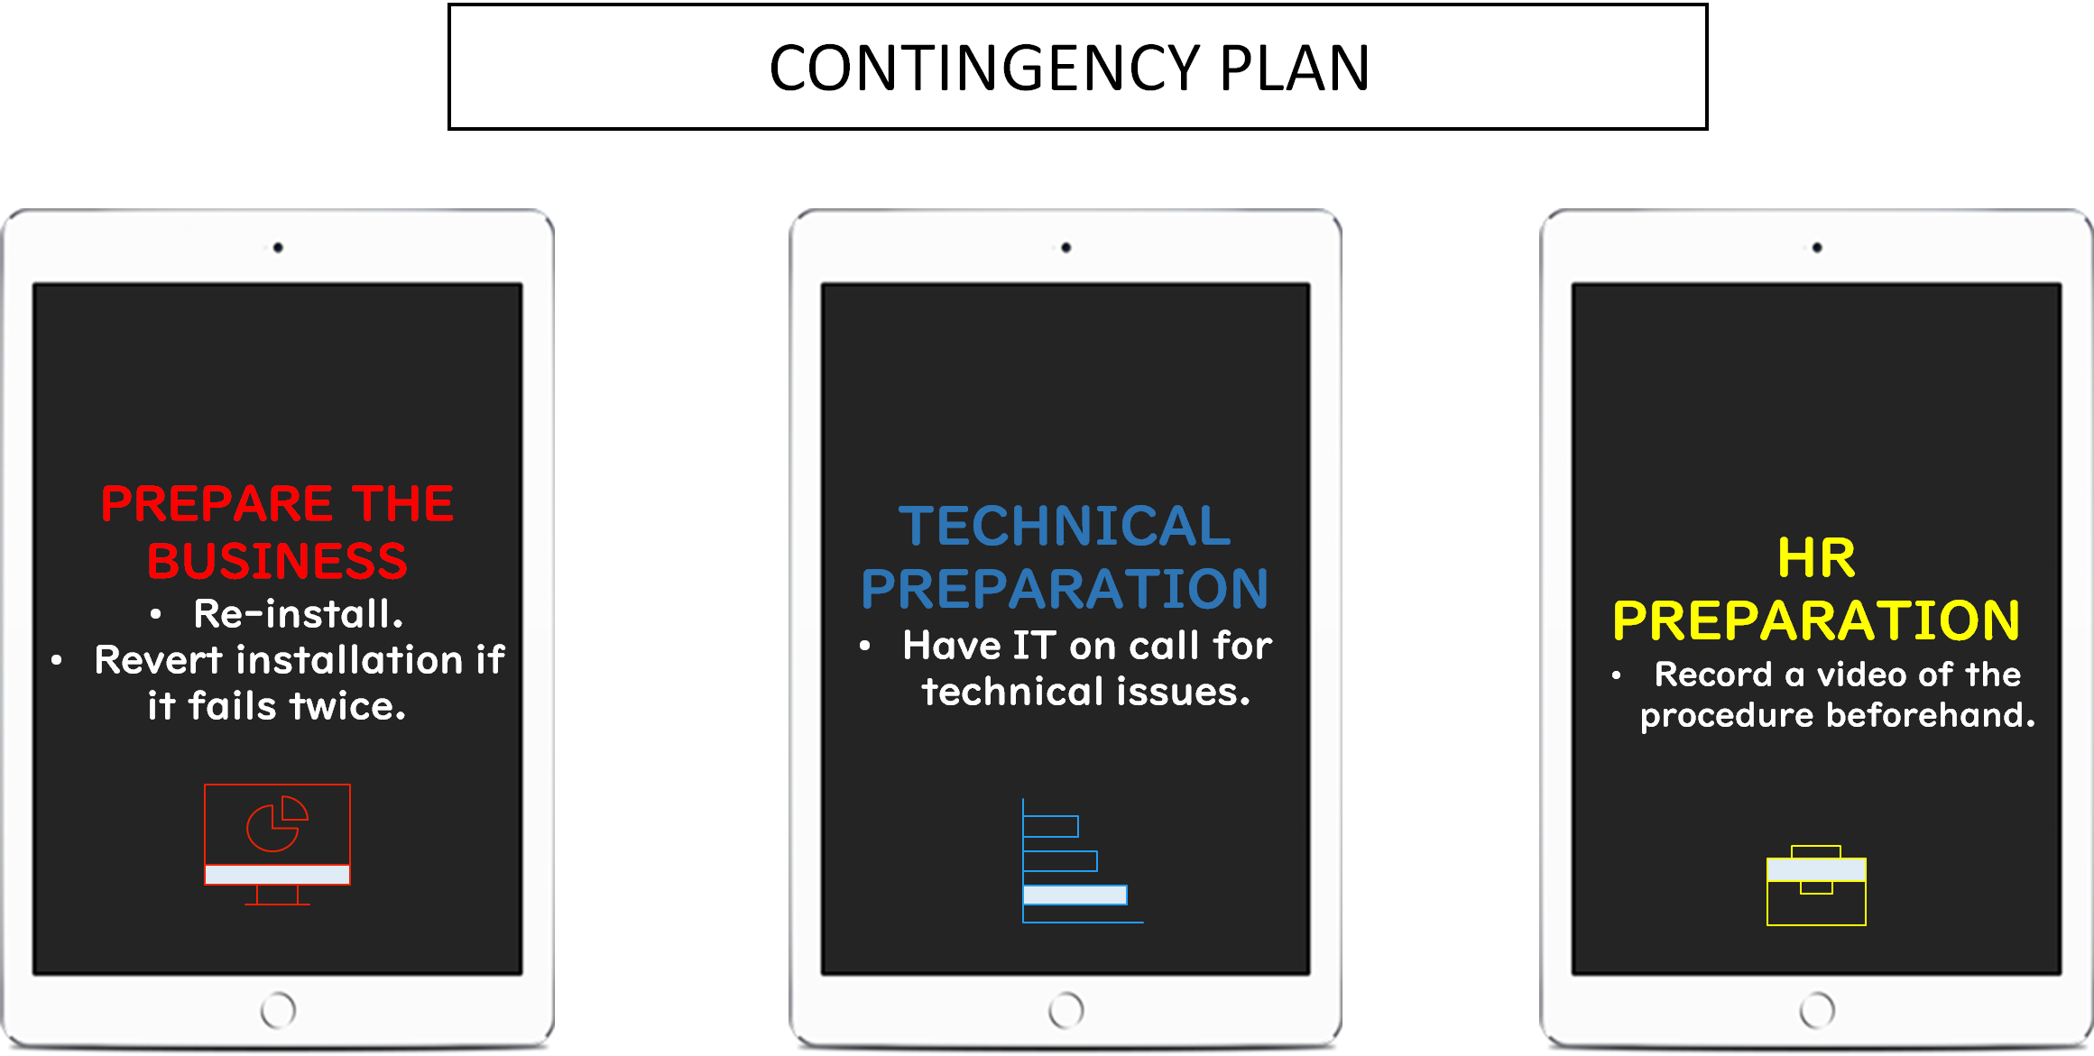

Slide 29
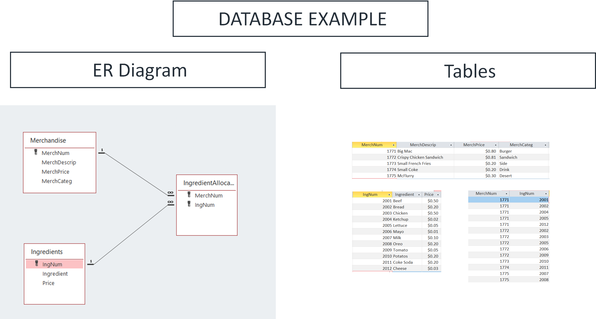

Slide 30
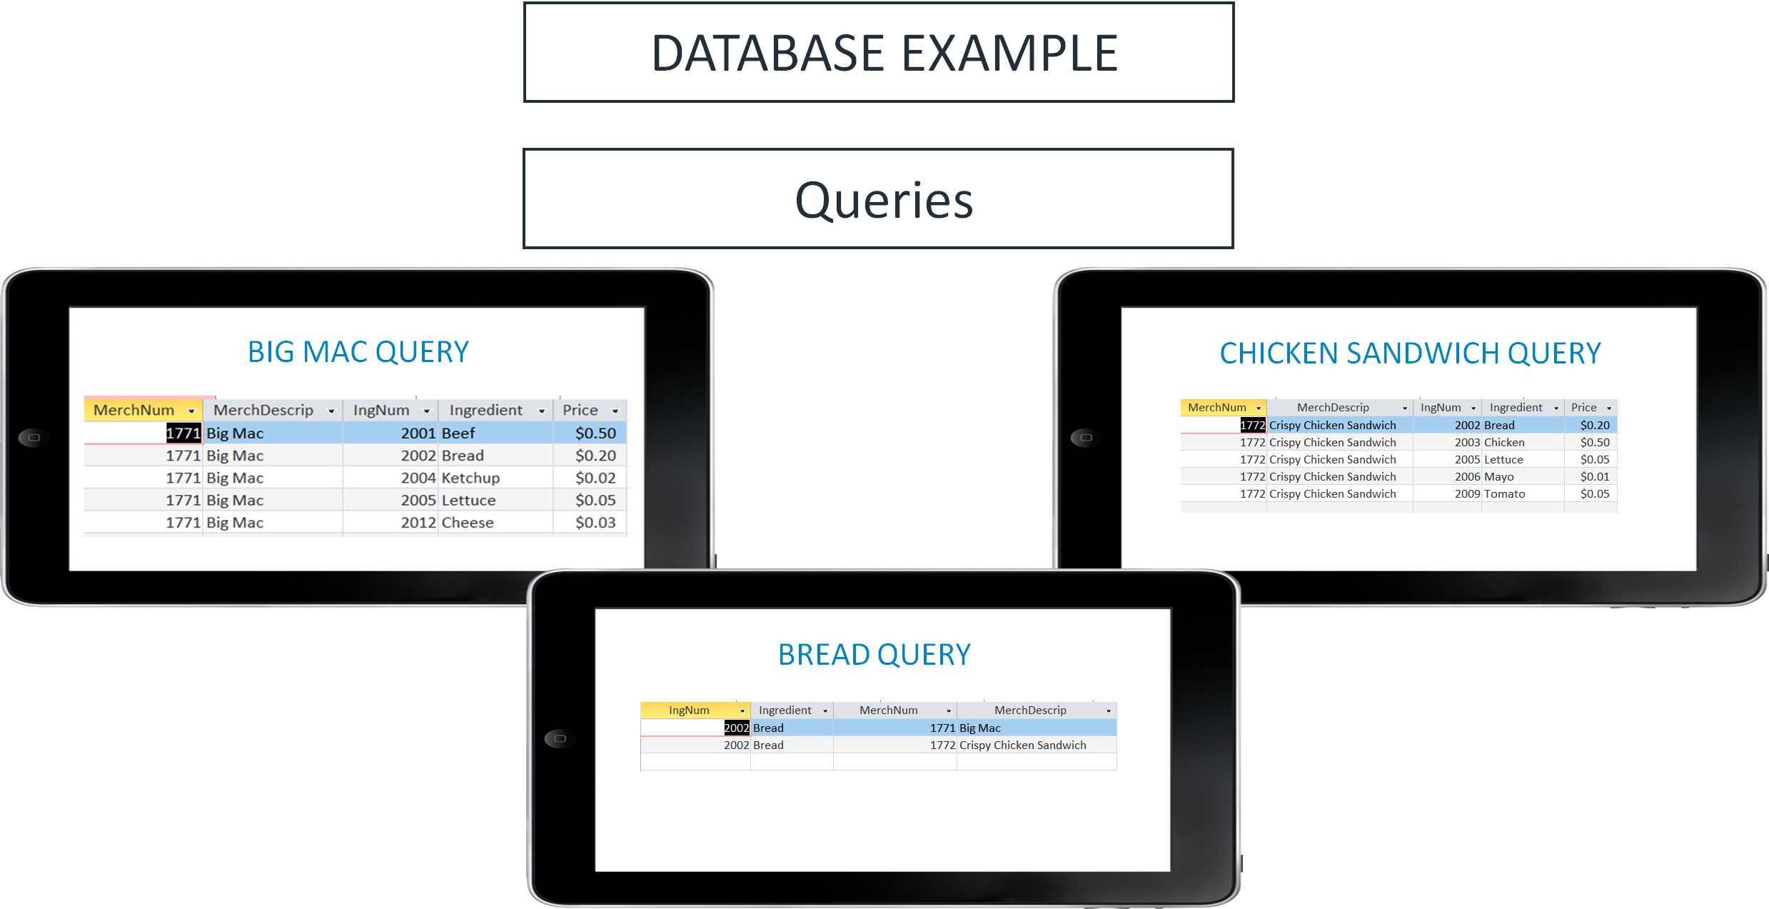

Slide 31
